Slide 1
SECURE DATA HIDING IN IMAGES USING STEGANOGRAPHY
CAPSTONE PROJECT
Presented By:
Student Name : Theertha Raveendranath
College Name : NMAM Institute of Technology
Department : Computer and Communication Engineering

Slide 2
OUTLINE
Problem Statement
Technology used
Wow factor
End users
Result
Conclusion
Git-hub Link
Future scope

Slide 3
Problem Statement
In today's digital world, securing confidential information is crucial to prevent unauthorized access. Traditional encryption methods protect data, but they may attract attention from potential attackers.
Steganography offers an alternative by concealing information within digital media, making it invisible to casual observers.
This project implements image-based steganography, where a secret message is embedded into an image at the pixel level. The message is encoded within the pixel values, and only users with the correct passcode can retrieve and decrypt it. This ensures secure and hidden communication without raising suspicion.
The solution is developed using Python and OpenCV, enabling users to:
Encrypt a text message into an image without visually altering it.
Decrypt the hidden message using a passcode.
Ensure data security while maintaining the integrity of the original image.
This project demonstrates the power of steganography in secure communication and data hiding, providing a practical approach for transmitting confidential messages without detection.

Slide 4
Technology used
Programming Language: Python
Libraries:cv2,os(built-in python),String
OpenCV – For image processing (loading, modifying, and saving images)
OS Module – For file handling and system operations
Platform:
Windows OS (Tested on Command Prompt and IDLE)

Slide 5
Wow factors
Secure Data Hiding: Uses image steganography to embed secret messages inside images, making it difficult to detect.
Password Protection: Only users with the correct passcode can decrypt and retrieve the hidden message.
Lightweight & Simple: Uses minimal libraries, making it efficient and easy to implement.
Custom Encoding Method: Maps characters to pixel values uniquely, ensuring message security.
No File Size Increase: Unlike other encryption methods, the image remains visually unchanged, preventing suspicion.
Cross-Platform Compatibility: Works on different operating systems, making it widely accessible.

Slide 6
End users
Students & Researchers – For learning about steganography and data security.
Companies & Organizations – To protect confidential information.
General Users – Anyone who wants to hide private messages in images.

Slide 7
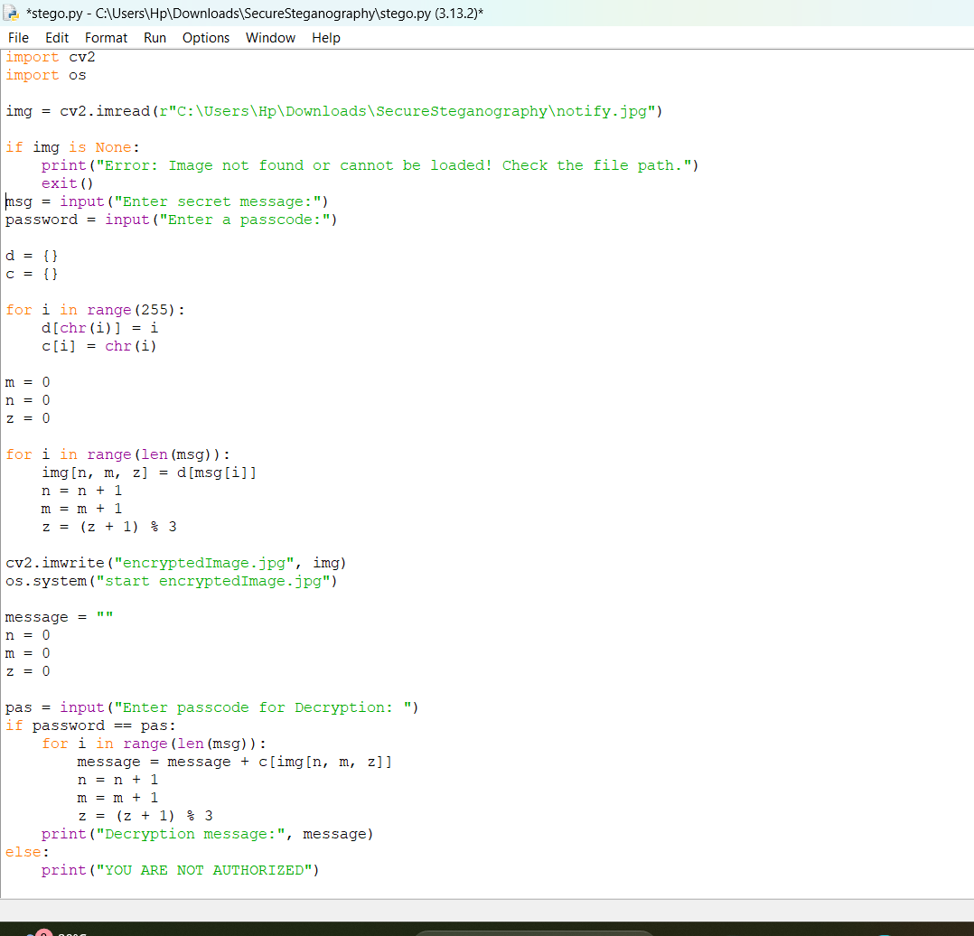
Results
Output 1:

Slide 8
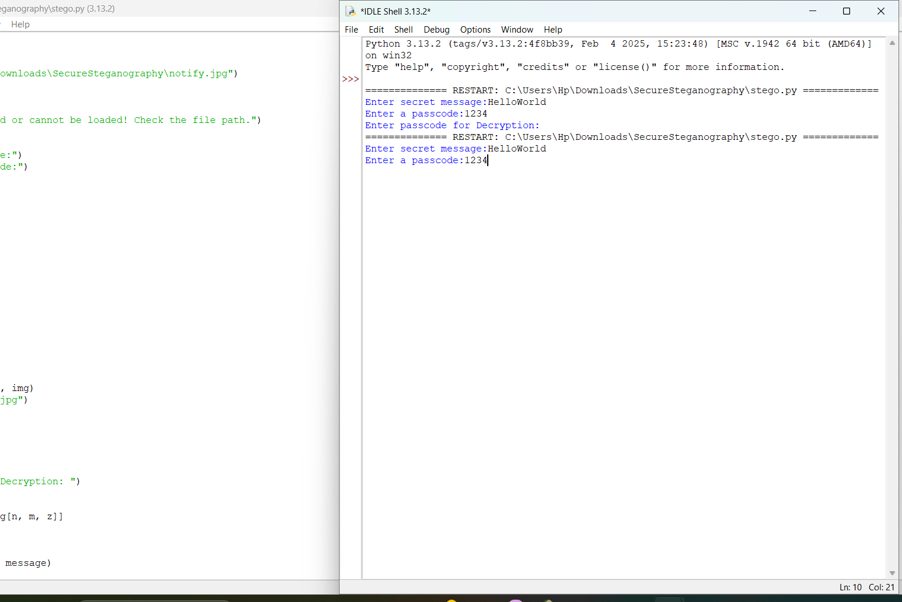
Results
Output 2:

Slide 9
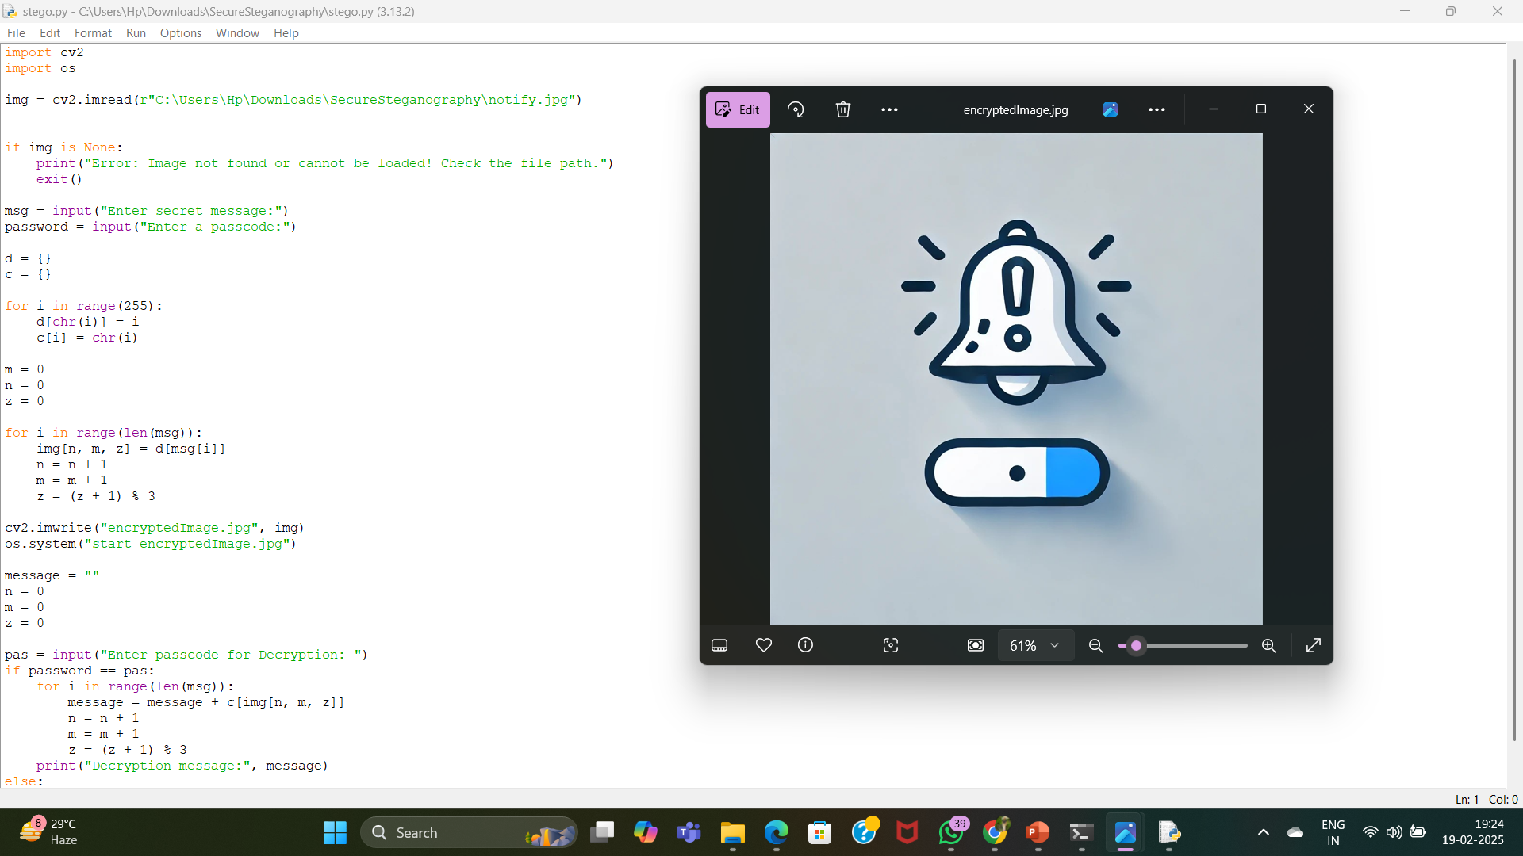
Results
Output 3:

Slide 10
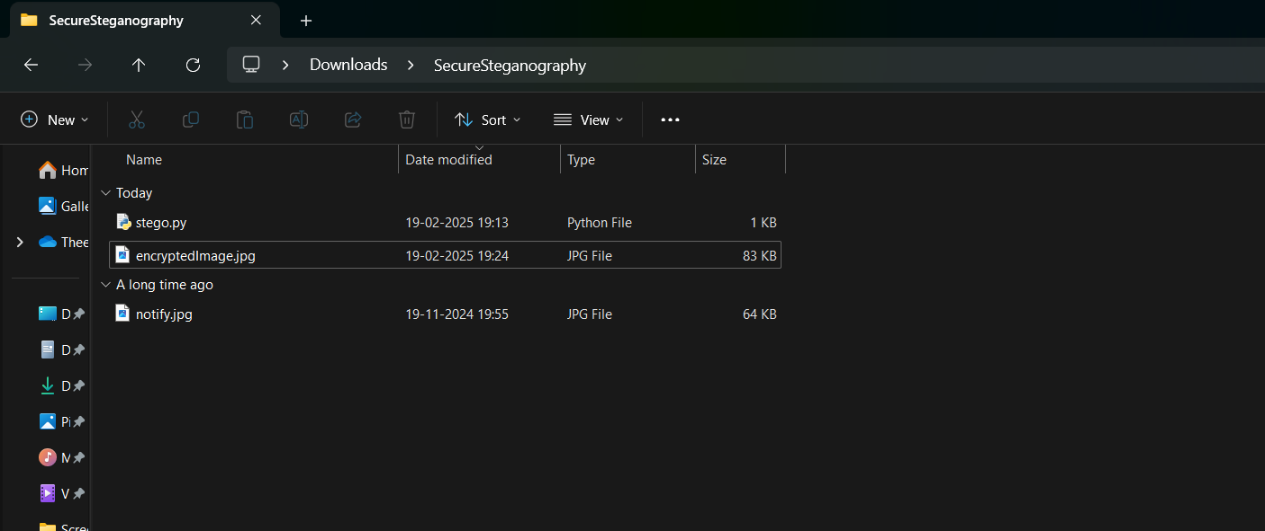
Results
Output 4:

Slide 11
Conclusion
In conclusion, this project effectively demonstrates a secure and efficient method for data hiding using image steganography. By embedding secret messages within images, it ensures confidentiality while maintaining accessibility. Implemented using Python and OpenCV, it provides a practical approach for secure communication and personal data protection. This technique holds significant potential in cybersecurity applications, making it a valuable tool for digital security

Slide 12
GitHub Link
https://github.com/theerthachandu/SecureSteganography.git

Slide 13
Future scope(optional)
This project can be further improved by enhancing the encryption techniques to make data hiding more secure:
Enhanced Security: Improve encryption techniques to make data hiding more secure and resistant to hacking
Support for More File Formats: Extend the project to hide data in audio, video, and PDF files
AI-Based Protection: Implement AI-based steganalysis resistance to prevent detection by advanced tools
Cloud Integration: Allow users to store and retrieve steganographic images securely from cloud platforms
User-Friendly Interface: Develop a graphical user interface (GUI) to make the tool easier for non-technical users

Slide 14
THANK YOU

